Slide 1
Lecture 18
DSP-Based Analog Circuit Testing
Definitions
Unit Test Period (UTP)
Correlation
Fourier Voltmeter
Non-Coherent Sampling
Multi-Tone Testing
CODEC Testing
Event Digitization
Summary

Slide 2
Definitions
Intermodulation – Non-linear response of DUT creates a spectral line at sum or difference of analog testing frequencies
Intrinsic Parameter -- Defines DUT specification
Primitive Band, 0 f N Δ / 2
Contains all sampled waveform information
Multi-Tone Testing – Stimulate DUT with a multi-frequency composite sinusoidal analog waveform
Primitive Frequency, Δ = 1 / unit test period

Slide 3
More Definitions
Quantization Error – Introduced into measured signal by discrete sampling
Quantum Voltage – Corresponds to flip of LSB of converter
Single-Tone Test -- Test of DUT using only one sinusoidal tone
Tone – Pure sinusoid of f, A, and phase φ
Transmission (Performance) Parameter -- indicates how channel with embedded analog circuit affects multi-tone test signal
UTP – Unit test period: joint sampling period for analog stimulus and response

Slide 4
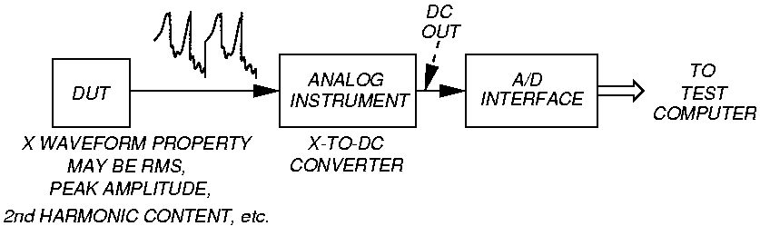
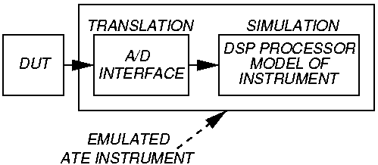
Emulating Instruments with Fourier Transforms
Conventional analog tester
© 1987
IEEE
DSP-based
tester

Slide 5
Equivalent Calculations
1
P
Analog tester: V (DC) = ___ V_{in} dt
V = ____ | V_{in} | dt
V (RMS) = ____ V²_{in} dt
DSP-based tester: V (DC) = ___ V (I)
V = ___ | V (I) |
V (RMS) = ___ V (I)²
P
(
abs.
avg.
)
1
P
P
1
P
N
P
Σ
1
N
I = 1
(
abs.
avg.
)
N
Σ
1
N
I = 1
N
Σ
1
N
I = 1

Slide 6
Coherent Testing

Slide 7
Coherent Measurement Method
Unit Test Period is integration interval P
Has integral # of stimulus periods M
Has integral # of DUT output periods N
Stimulus & sampling are phase locked
To obtain maximum information from sampling, M and N are relatively prime
F_{t} – tone frequency
F_{s} – sampling rate

Slide 8
CODEC Testing Example
Serial ADC in digital telephone exchange
Sampling rate 8000 s/s
Audio frequency range 300 – 3400 Hz
F_{t} = 1000 Hz F_{s} = 8000 s/s
P = 50 ms
M = 50 cycles N = 400 samples
Problem: M and N not relatively prime
All samples fall on waveform at certain phases – sample only 8/255 CODEC steps

Slide 9
CODEC Testing Solution
Set F_{s} = 400 ks/s – impossibly fast
Better – Adjust F_{t} slightly, signal sampled at different points
Necessary relationships:
    F_{t} = M x Δ F_{s} = N x Δ
    Δ = 1 / UTP
    F_{t} M
    F_{s} N
=

Slide 10
Good CODEC Parameters
F_{t} = 1020 Hz F_{s} = 8000 s/s
P = UTP = 50 ms Δ = 20 Hz
M = 51 cycles N = 400 samples
M and N now relatively prime
All samples fall on waveform at different phases – samples all CODEC steps

Slide 11
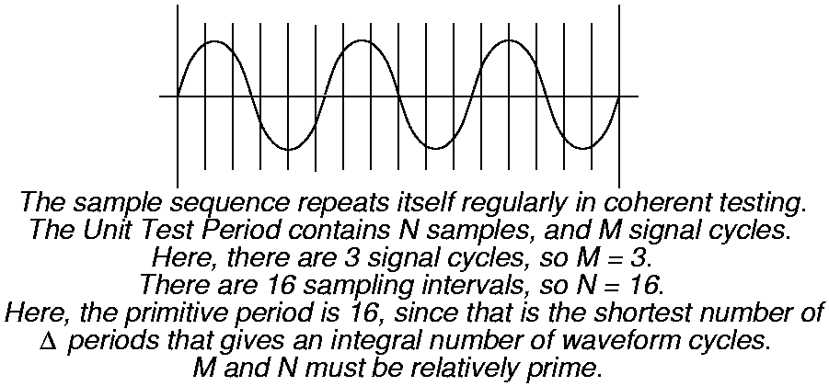
Unit Test Period
© 1987 IEEE

Slide 12
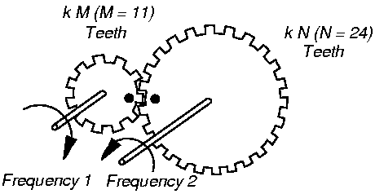
Mahoney’s Gear Train Analogy
© 1987 IEEE

Slide 13
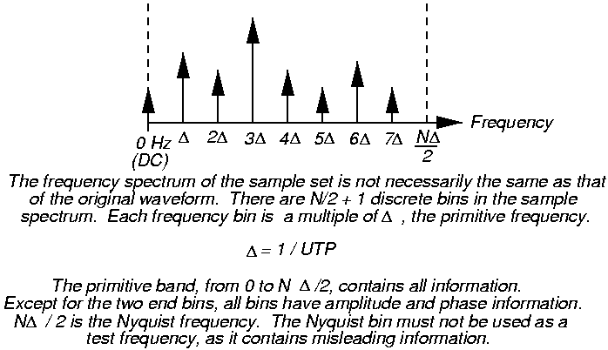
Primitive Frequency
© 1987 IEEE

Slide 14
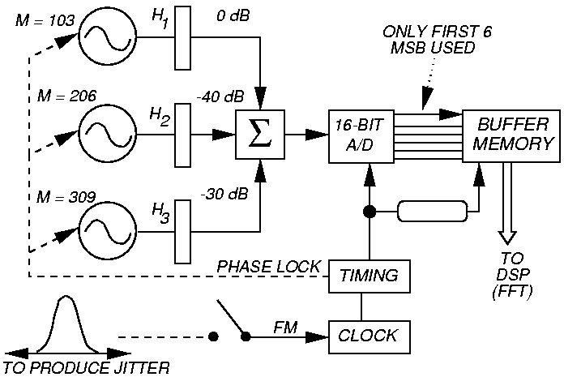
Spectral Test of A/D Converter
© 1987 IEEE

Slide 15
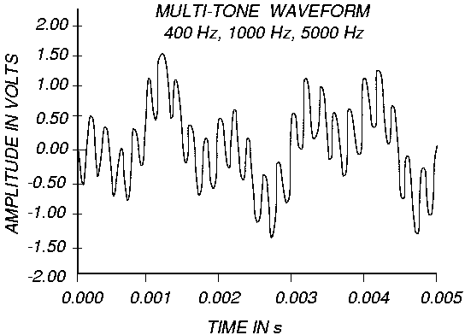
Example Multi-Tone Test Stimulus
© 1987 IEEE

Slide 16
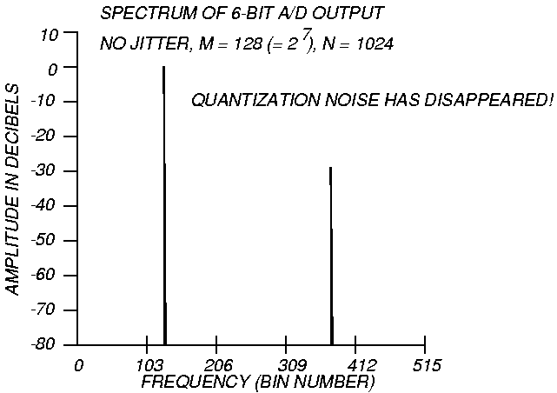
Bad A/D Converter Test
© 1987 IEEE

Slide 17
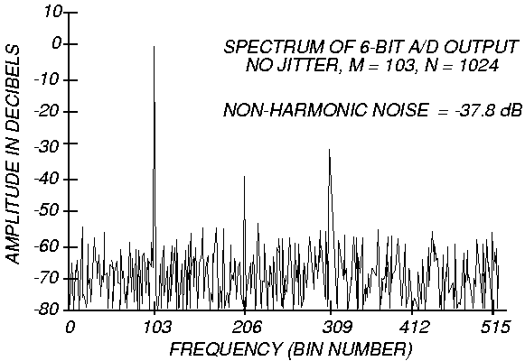
Good A/D Converter Test
© 1987 IEEE

Slide 18
Coherent Filtering
Eliminates filter settling time & non-linear analog circuits – big speed-up
Never put a filter between DUT and digitizer – introduces settling time longer than a signal period
  Settling time = 5 to 10 x
  to get to 0.1 % accuracy
1
3dB bandwidth

Slide 19
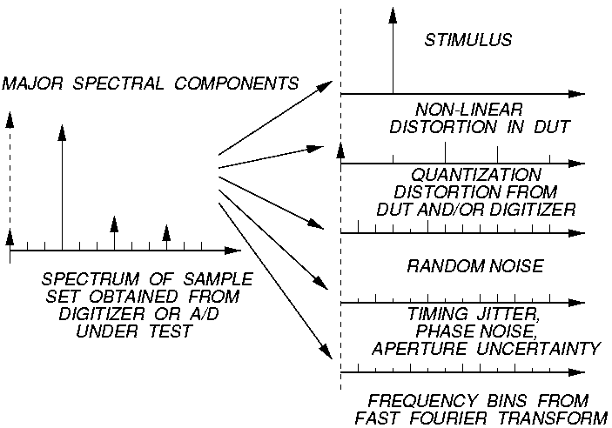
Spectral DSP-Based Testing Components
© 1987 IEEE

Slide 20
Correlation
τ = programmable delay
A, B are functions
R = coherent correlation
G = gain or scale factor
P = period of waveform
G = ______________________________
Normalized correlation: -1 R +1
R (t) = G A (t) B (t - τ ) dt
1
RMS (A) x RMS (B) x UTP
P

Slide 21
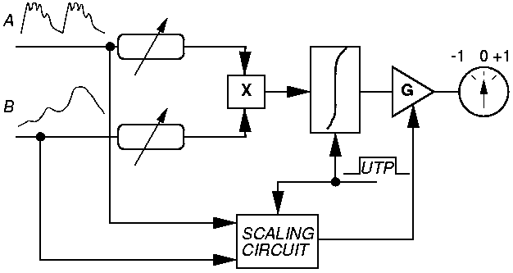
Correlation Model
© 1987 IEEE
  Cross-correlation – compare 2 different signals
  Autocorrelation – compare 1 signal with itself

Slide 22
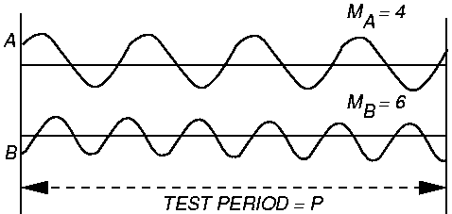
Fourier Voltmeter
1st Principle
© 1987 IEEE
For signals A and B, if P is infinite, R = 0. If P is finite and contains integer # cycles of both A and B, then cross-correlation R = 0, regardless of phase or amplitude

Slide 23
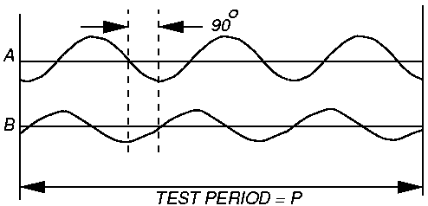
Fourier Voltmeter
2nd Principle
© 1987 IEEE
If signals A and B of same f are 90º out of phase, and P contains an integer J # of signal cycles, then cross-correlation R = 0, regardless of amplitude or starting point

Slide 24
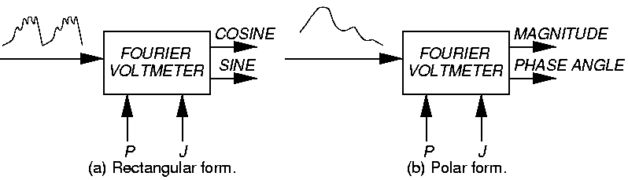
Two Forms of Fourier Voltmeter
© 1987 IEEE
P = Unit test period
J = # of signal cycles

Slide 25
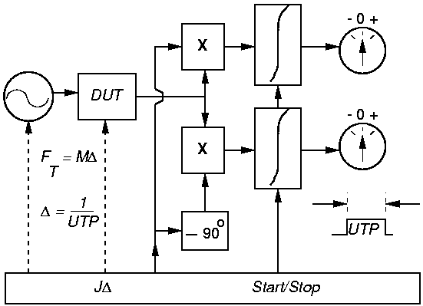
Analog Fourier Voltmeter Equivalent
© 1987 IEEE

Slide 26
Dot Product and Power
Software Fourier Voltmeter – dot product:
cosine part = X (I) C (I)
sine part = X (I) S (I)
C = cosine, S = sine
dB figures: Number of dB = 10 log
Number of dB = 20 log
Adjusted power computation:
Average sine wave power =
Σ
N
2
N
I = 1
Σ
N
2
N
I = 1
(
P2
P1
)
(
V2
V1
)
peak power
2

Slide 27
Orthogonal Signals – Benefit of Coherence
When 2 more more sinusoids are in circuit response, they are statistically orthogonal – 0 cross-correlation
Digital domain definition: Orthogonal if sum of index-by-index products = 0
  Statistically independent
  Each signal has separate, unique information
  When added linearly, resulting power is arithmetic sum of individual component powers

Slide 28
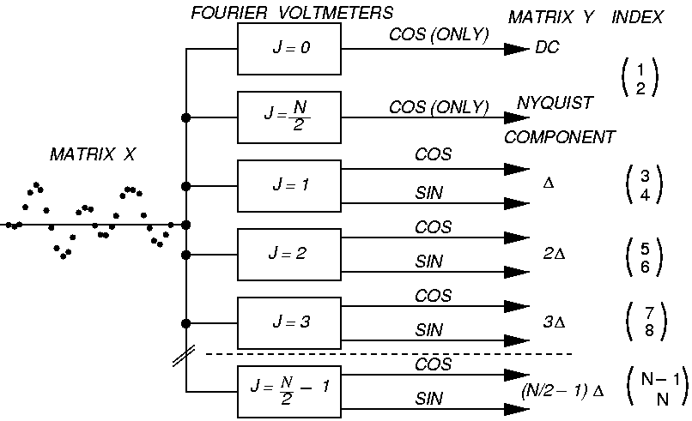
Conceptual Discrete Fourier Voltmeter
© 1987 IEEE

Slide 29
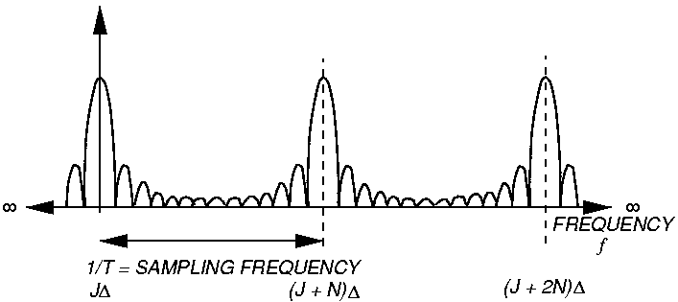
Fourier Voltmeter Voltage-Swept Response
© 1987 IEEE
|
sin ( π N T f’ )
N sin (π T f’ )
|
| G (f) | =
_______________
where f’ = f - J Δ

Slide 30
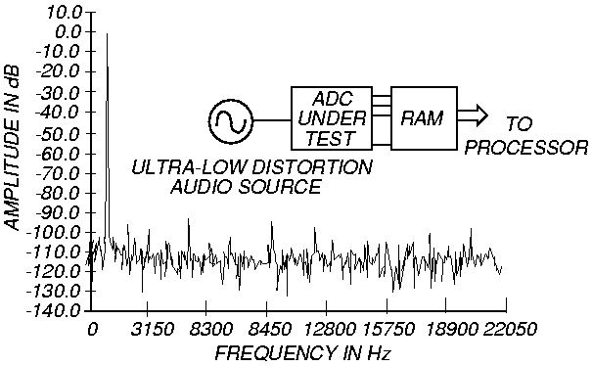
A/D Converter Spectrum
© 1987 IEEE
Audio source at 1076 Hz sampled at 44.1 kHz

Slide 31
Non-Coherent Testing

Slide 32
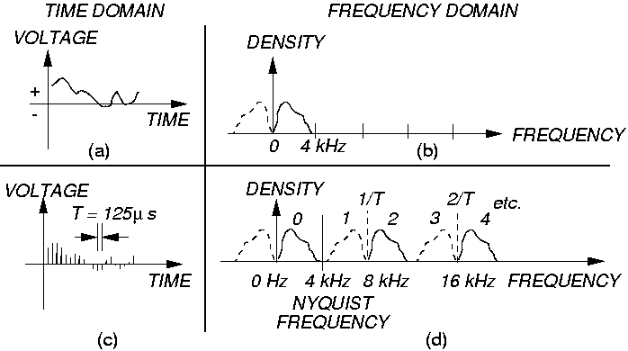
Non-Coherent Sampling for Speech
© 1987 IEEE

Slide 33
Universal Rule of Non-Coherent Sampling
If all signal spectral energy is in a spectrum of width W = f_{H} – f_{L},
Choose F_{s} so that [f_{L}, f_{H}] falls within two adjacent harmonics of F_{s} /2:
If f_{L} > , then > f_{H}
These two inequalities give Universal rule for non-coherent sampling:
n = image zone number,
0 = low-pass, 1 is band-pass case
f_{L}, f_{H} low, high frequencies
n F_{s}
2
(n + 1) F_{s}
2
2 f_{L}
n
2 f_{H}
n + 1
> F_{s} >

Slide 34
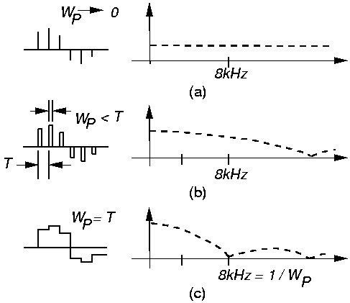
SIN x/x (sinc) Adjustment
© 1987 IEEE

Slide 35
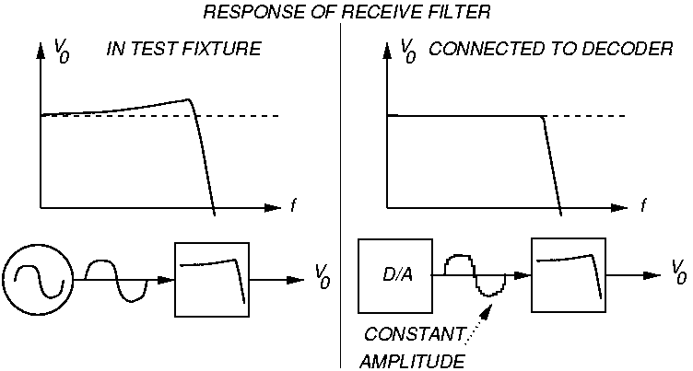
Hardware for Sinc Adjustment
© 1987 IEEE

Slide 36
Multi-Tone Testing

Slide 37
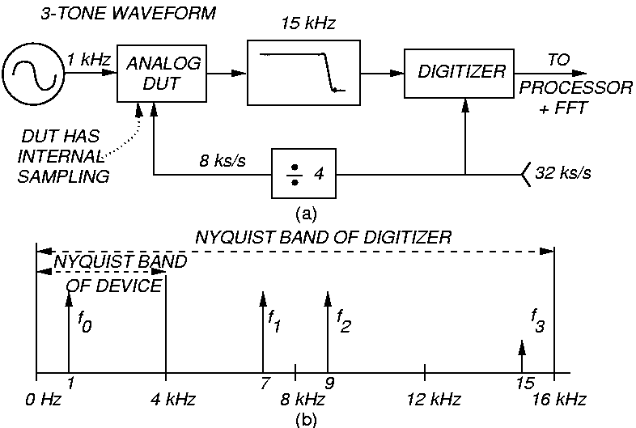
Test Setup
© 1987 IEEE

Slide 38
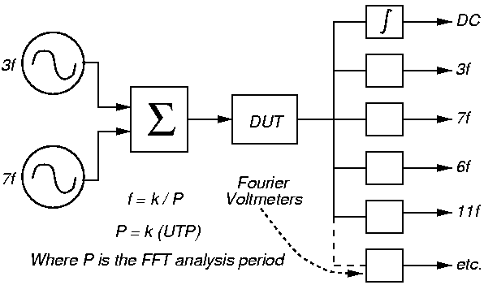
Coherent Multi-Tone Testing
© 1987 IEEE

Slide 39
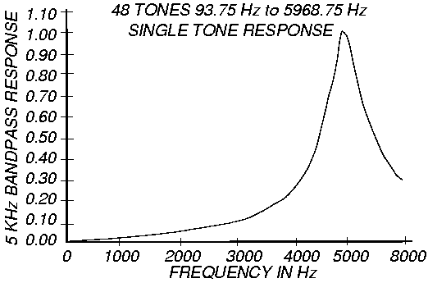
Single-Tone Test Example
© 1987 IEEE

Slide 40
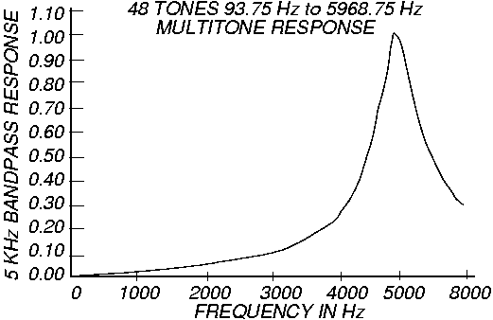
Multi-Tone Test Example
© 1987 IEEE

Slide 41
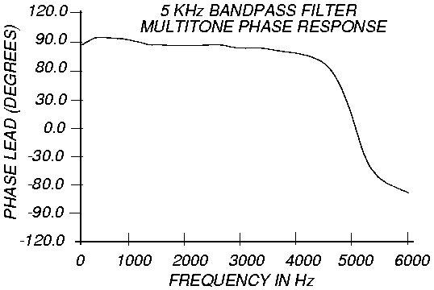
Multi-Tone Phase Response
© 1987 IEEE

Slide 42
Total Harmonic Distortion (THD)
Measures energy appearing in harmonics (H2, H3, …) of fundamental tone H1 as % of energy in the fundamental frequency in response spectrum
THD =
H₂
10
H₃
10
H₁₀
10
10 + 10 + … + 10
10
H₁
20

Slide 43
Error Sources and Accuracy
Multi-tone waveforms
  Tone amplitudes must be small to prevent peak-to-peak amplitudes from burning out the DUT (leads to smaller Signal/Noise ratio)
  When DUT has no quantization or digital filtering, just as accurate
CODECs
  Discontinuous time sampling, discontinuous amplitude functions
  Interact with test signals and measurement process
  Uncertainty – synchronous interference, discontinuous functions
Book has test adjustments to reduce error

Slide 44
CODEC Testing

Slide 45
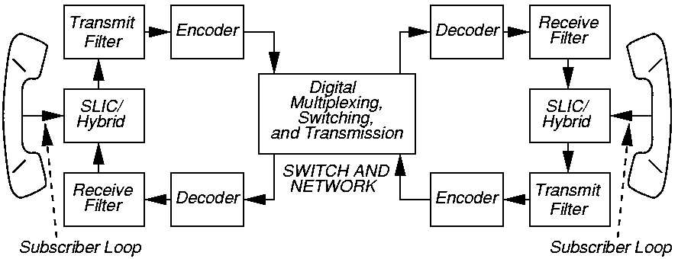
CODEC Example
© 1987 IEEE
    SLIC – Subscriber loop interface circuit
    PCM – Pulse Code Modulation

Slide 46
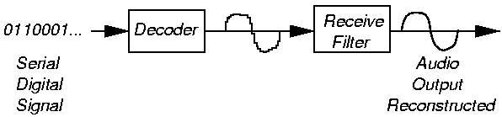
Digitized Signal Reconstruction
© 1987 IEEE

Slide 47
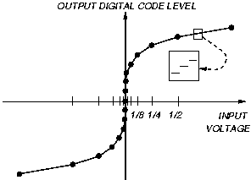
Law or Floating Point Encoding (Companding)
© 1987 IEEE

Slide 48
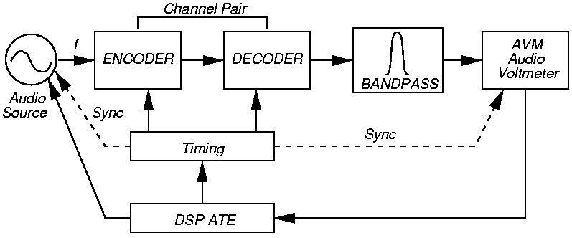
Full Channel Gain Test
© 1987 IEEE

Slide 49
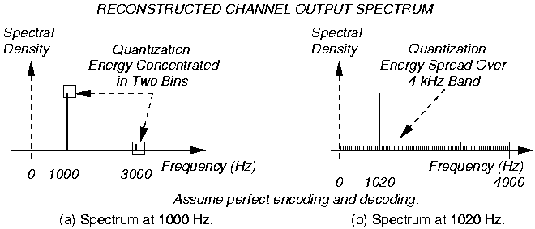
Influence of Test Frequency Selection
© 1987 IEEE

Slide 50
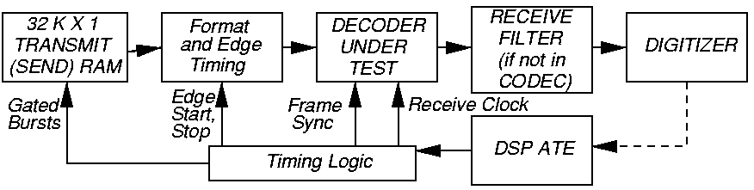
Half Channel Test Setup
© 1987 IEEE

Slide 51
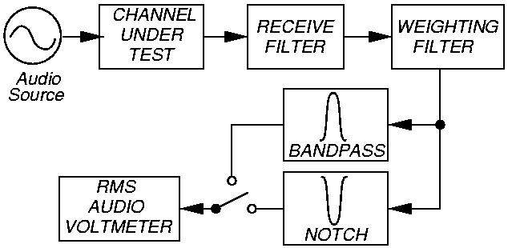
Signal-to-Total Distortion Test
© 1987 IEEE

Slide 52
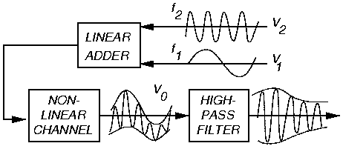
Intermodulation Distortion Test Waveforms
© 1987 IEEE

Slide 53
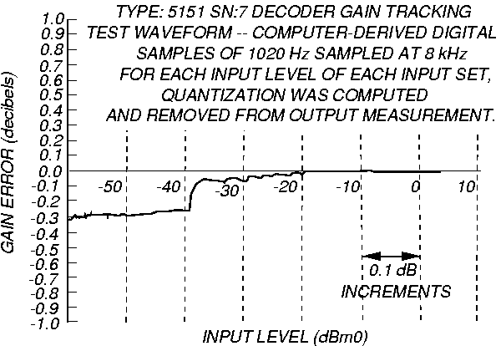
Gain Tracking Characterization Test
© 1987 IEEE

Slide 54
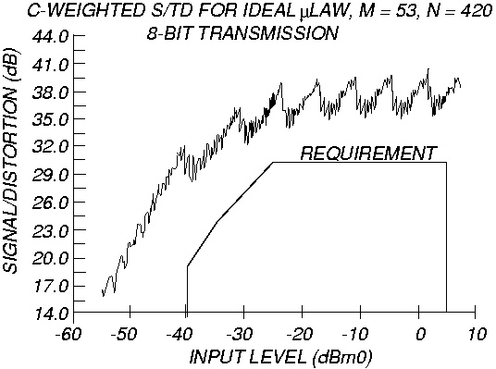
Signal to Total Distortion Characterization
© 1987 IEEE

Slide 55
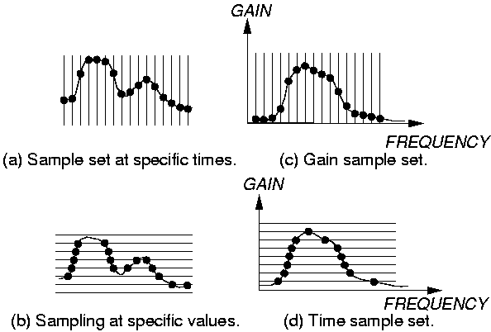
Event Digitization
© 1987 IEEE

Slide 56
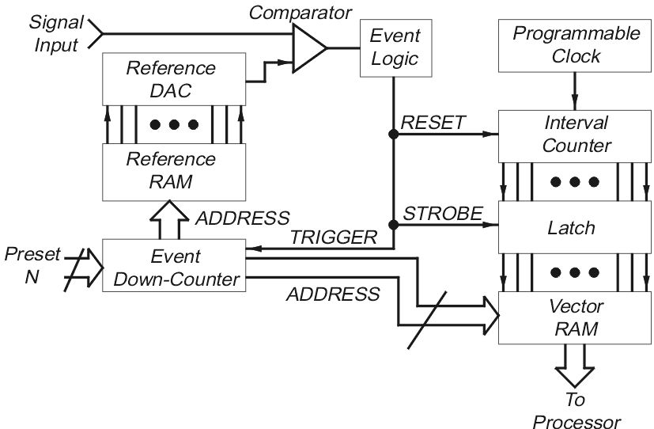
ATE Event Digitizer Block Diagram

Slide 57
DSP Testing Summary
Analog testing greatly increasing in importance
  System-on-a-chip
  Wireless
  Personal computer multi-media
  Automotive electronics
  Medicine
  Internet telephony
  CD players and audio electronics
Analog testing NOT deterministic like digital
  Statistical testing process, electrical noise

